Slide 1


ROUTE OPTIMIZATION
FOR AMBULANCE
19CSE212
PRESENTED BY B LOKESH CHANDRA - CB.EN.U4CSE21211 N.SANDEEP -CB.EN.U4CSE21244

Slide 2
TABLE OF CONTENTS
Introduction and Objective
Hybrid Data Structure Implementation
Practical Application
Time and Space complexity
Experimental Evaluation and Result
Discussion and conclusion

Slide 3
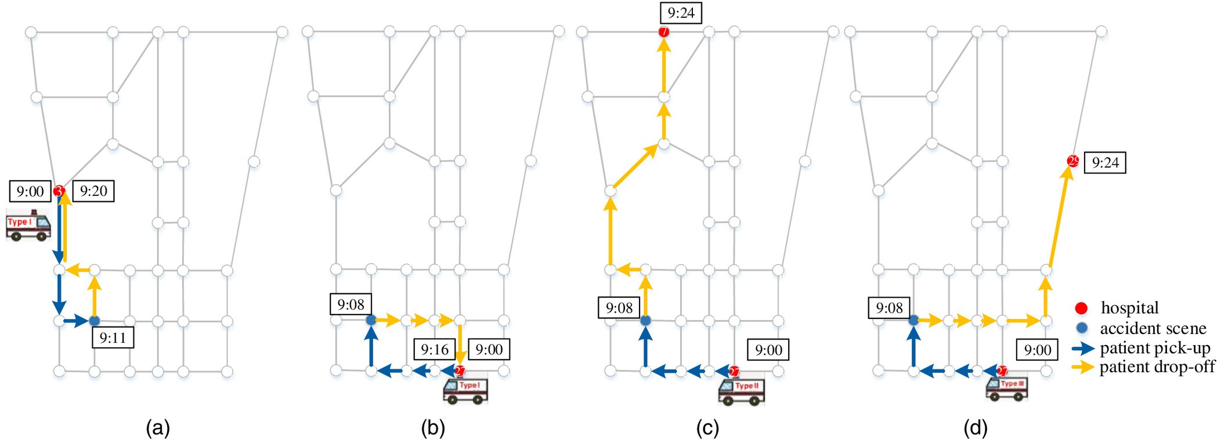

Slide 4
1. Introduction and Objective
To maximize patient outcomes and decrease response times,the aim of ambulance routeoptimization is to find the most efficient paths for emergency vehicles.
By carefully considering various factors like live traffic situations, the focus is on identifying the quickest and most direct routes to ensure timely medical care is delivered to those who need it.

Slide 5
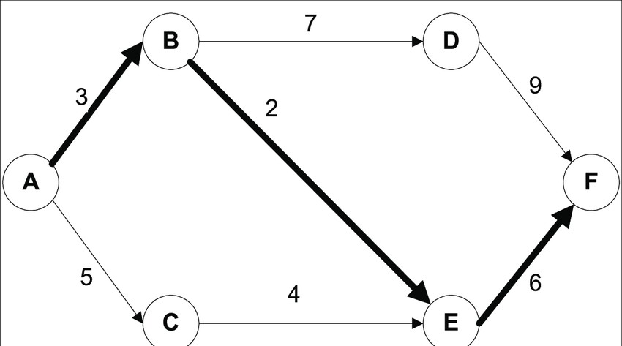
IMPLEMENTATION
Graph: The Graph class represents a road network and uses a dictionary-based
adjacency list representation

Slide 6
Priority Queue (Heap): The heapq module is used to implement the Priority Queue data structure
list: This list, defined within the Graph class, is used to store information about each node in the graph

Slide 7
Practical Applications
Emergency Medical Services
Disaster Management
Healthcare Facility Coordination
Logistics and Delivery Services
Public Transportation
Ride-Sharing and Taxi Services

Slide 8
In summary, the hybrid data structure used for route optimization of rescue routes has practical applications in emergency services, disaster management, medical logistics, public transportation, and transportation-based services. By leveraging these data structures, organizations can increase efficiency, reduce response time, and improve resource allocation in their respective areas.

Slide 9
4. Time and Space complexity
Time
Dijkstra's Algorithm:
- The overall time complexity of Dijkstra's algorithm is O((V + E) log V).
Adding a Node:
- Adding a node to the graph has a time complexity of O(1) because it involves adding an entry to the hash table.
3. Adding an Edge:
- Adding an edge between two nodes has a time complexity of O(1) because it involves updating the adjacency list in the hash table.

Slide 10
4. Displaying the Graph:
- The time complexity is O(V + E) because it visits each node and its connected edges once.
5. Inputting the Graph Information:
- The time complexity for inputting the graph information depends on the number nodes (V) and edges (E).

Slide 11
space
1.Graph Representation::O(V + E). 2.Priority Queue (Heap):O(V) 3.Hash Table:is O(V + E)
4. Other Variables:
the space complexity of the hybrid data structure is O(V + E),

Slide 12
5. Experimental Evaluation and Result

Slide 13
6.CONCLUSION
The implemented hybrid data structure in the code, which combines graph representation, priority queue (heap), and hash table, offers practicality and effectiveness for solving the ambulance route optimization problem. It provides efficient operations and enables effective management of the graph data, resulting in optimized route planning and resource allocation.
However, there are also some limitations to consider.

